Slide 1


E and Ee Matra Words

Slide 2
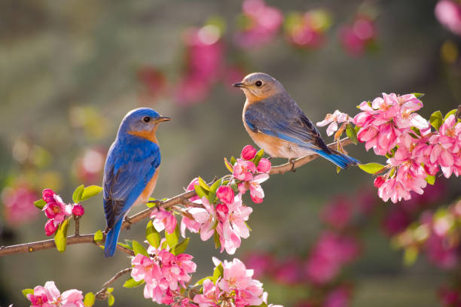
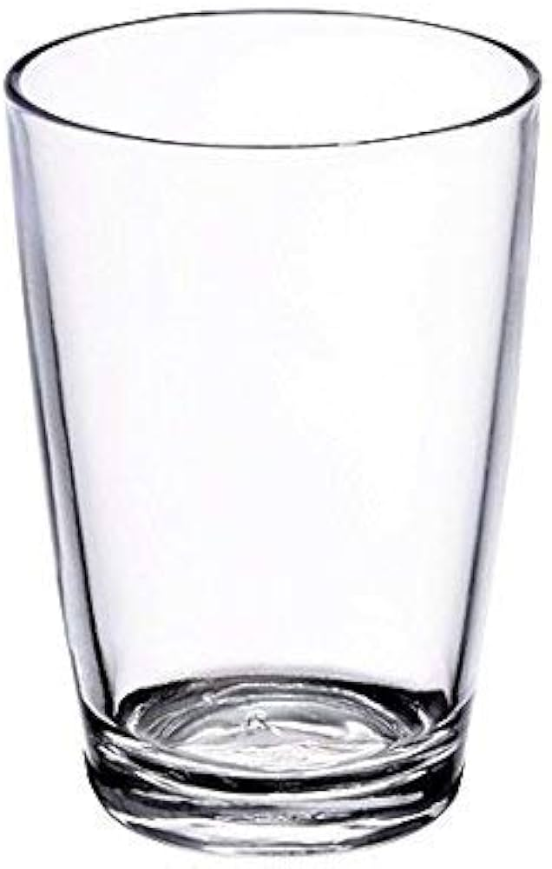
E and Ee Matra Words
Bird
Glass

Slide 3
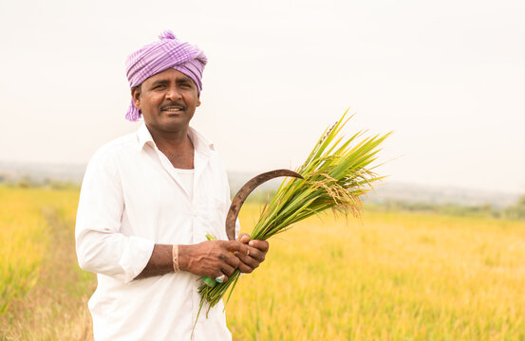

E and Ee Matra Words
Farmer
Write

Slide 4
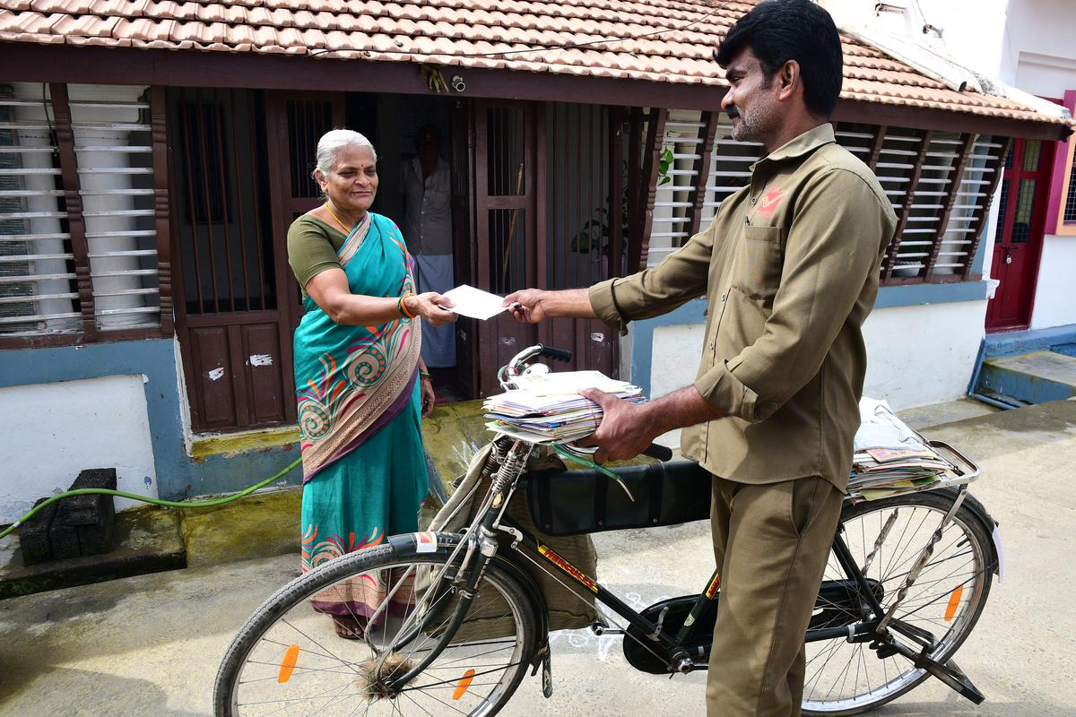
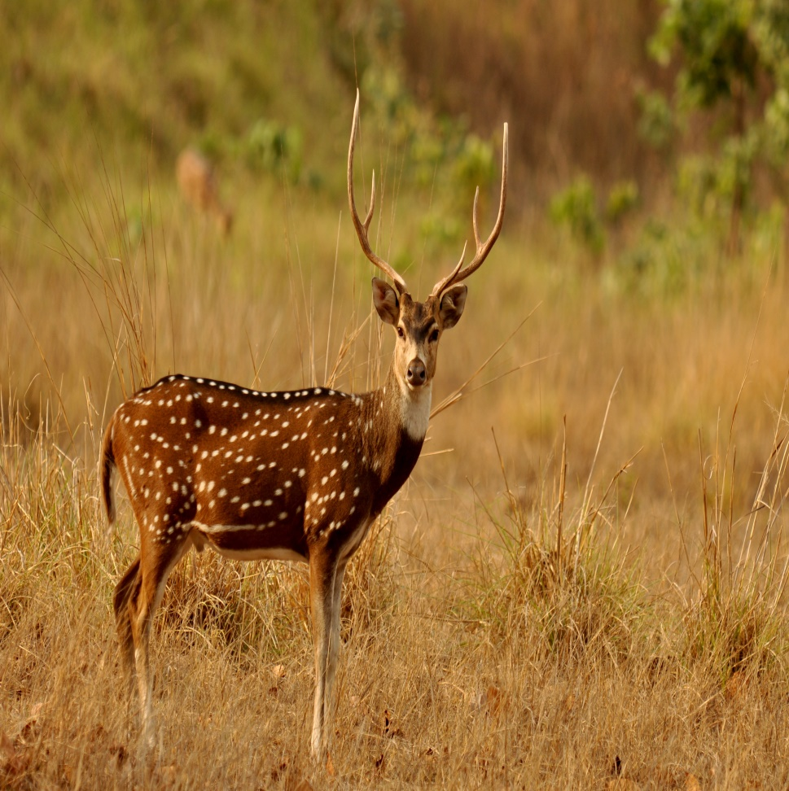
E and Ee Matra Words
Postman
Deer

Slide 5
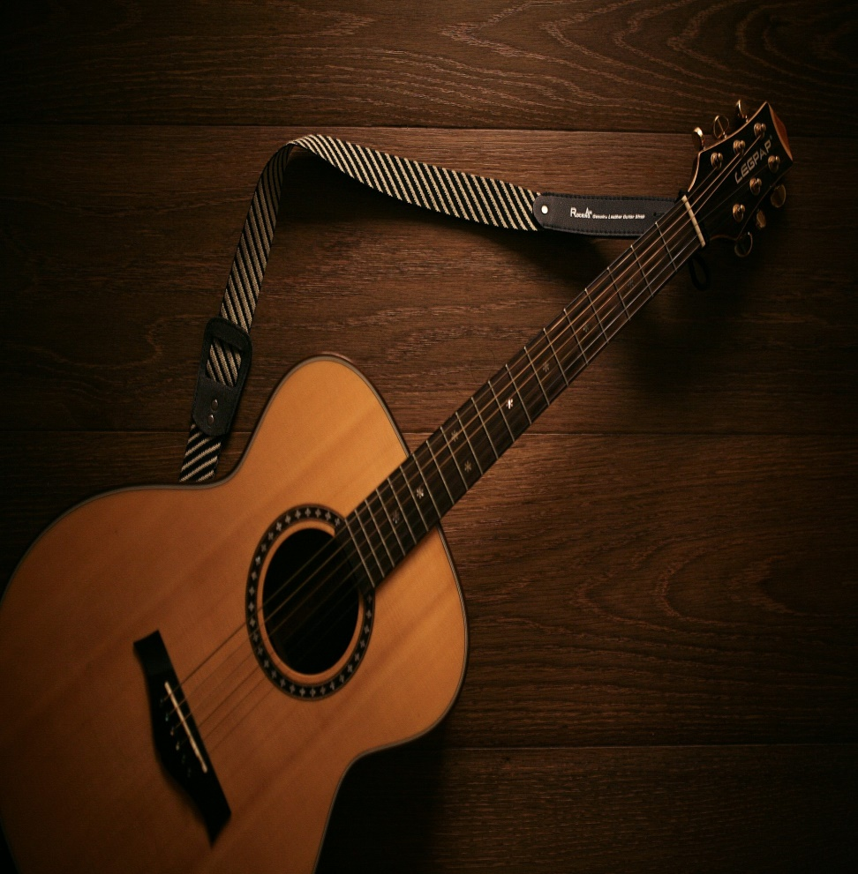
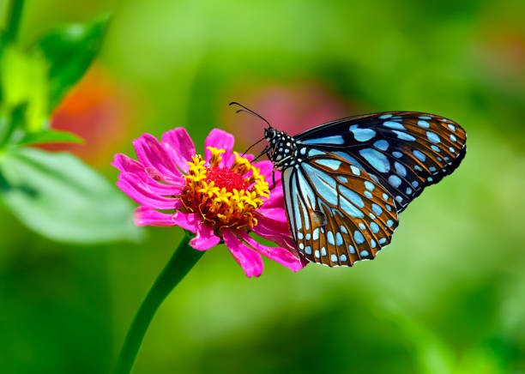
E and Ee Matra Words
Guittar
Butterfly

